Slide 1
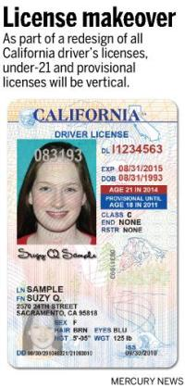
Provisional License Information
Effective January 1, 2006, a new law will increase driving restrictions for persons under the age of 18.
Provisional Driving Restrictions:
You must be accompanied and supervised by a licensed parent, guardian or other licensed driver 25 years of age or older or a licensed or certified driving instructor when you:
Transport passengers under 20 years of age at any time, for the first twelve months.
Drive between 11 pm and 5 am for the first twelve months.
To determine if these restrictions apply to you, look at the date on your driver license. The date printed just to the left of your photograph is the date these restrictions begin. The new restrictions apply for 12 months following this date. For example: If the date on your license is May 7, 2005, you will have the above restrictions through May 7, 2006. Violation of either restriction can result in a fine and/or community service.
Persons under 18 may not be employed to drive a motor vehicle. When you turn 18 years of age, the provisional part of your license ends. You may continue to drive as an adult using your photo license, which will expire on your 5th birthday after the date you applied.
*DMV Driver Handbook 2013
(760) 440-0371
www.psc411.com

Slide 2
Exceptions to Provisional License Restrictions*
When reasonable transportation is not available and it is necessary for you to drive, the law grants the following exceptions for minors to drive between 11 pm and 5 am or to transport an immediate family member unaccompanied and unsupervised.
The law allows the following exceptions when reasonable transportation is not available and it is necessary for you to drive.
A signed note must be kept in your possession for any of these exceptions explaining the necessity and the date when the driving necessity will end (except emancipated minors).
Medical necessity when reasonable transportation alternatives are inadequate. The note must be signed by your physician, and contain the diagnosis and probable date of recovery.
Schooling or school–authorized activity. The note must be signed by your school principal, dean, or his/her designee.
Employment necessity and the need to operate a vehicle as part of your employment. The note must be signed by your employer verifying employment.
Your necessity or the necessity of an immediate family member.
The note must be signed by your parent or legal guardian.
If you are an emancipated minor, no documentation is needed. However, you must have already declared yourself emancipated and provided DMV with Proof of Financial Responsibility (SR 1P) in lieu of your guarantors’ signatures.
*DMV Driver Handbook 2013
(760) 440-0371
www.psc411.com

